Slide 1


Chapter 9 The Hydrosphere

Slide 2
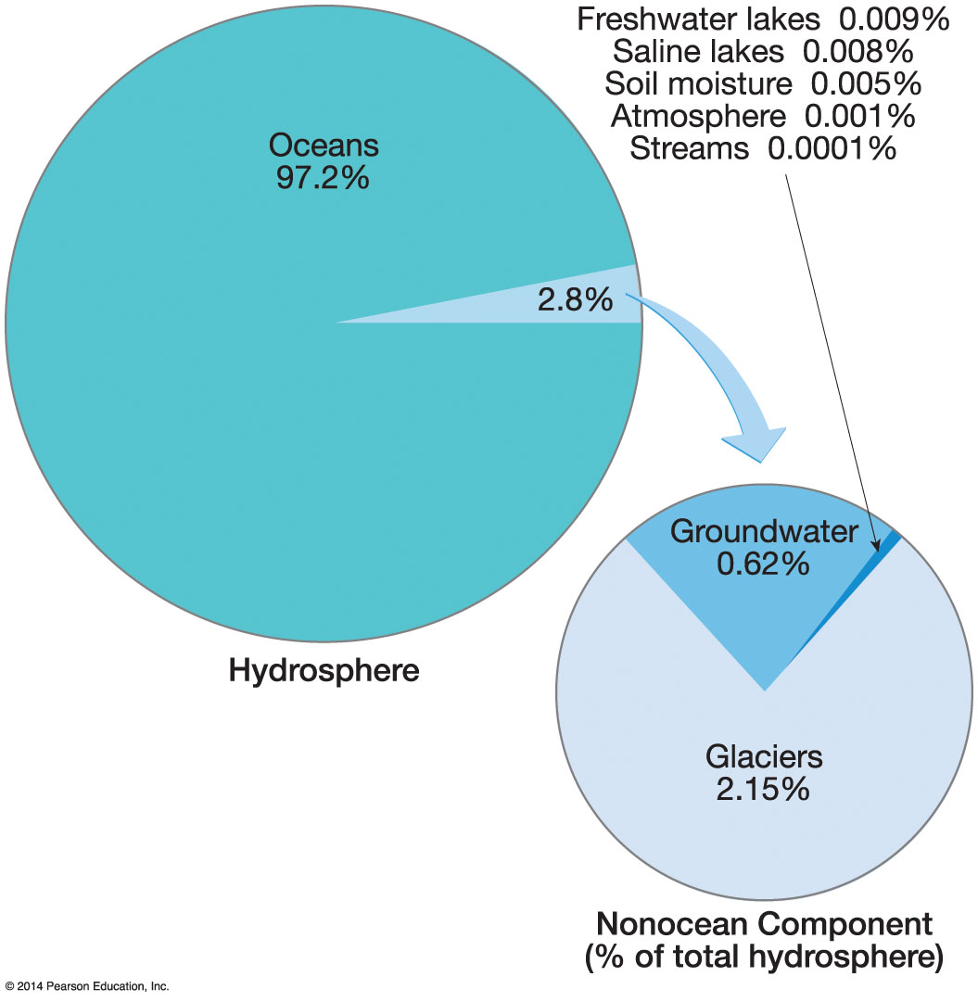

The Hydrologic Cycle
Bulk of Earth’s moisture (99%) is in storage in oceans, lakes, rivers, glacial ice, or rocks beneath the surface
Remaining fraction involved in a continuous sequence of movement and change
Movement is the hydrologic cycle

Slide 3
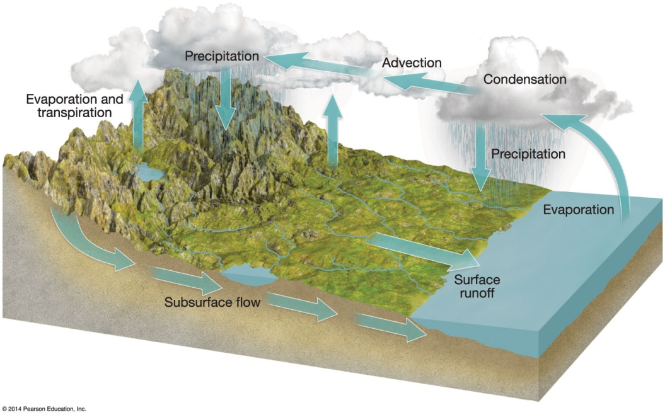

The Hydrologic Cycle

Slide 4

The Oceans
Vast majority of surface is oceans
Number of oceans
Four principal parts
Pacific – largest, occupies 1/3 of total Earth surface area
Atlantic – less than half the size of the Pacific
Indian – Slightly smaller than Atlantic
Arctic – small and shallow

Slide 5
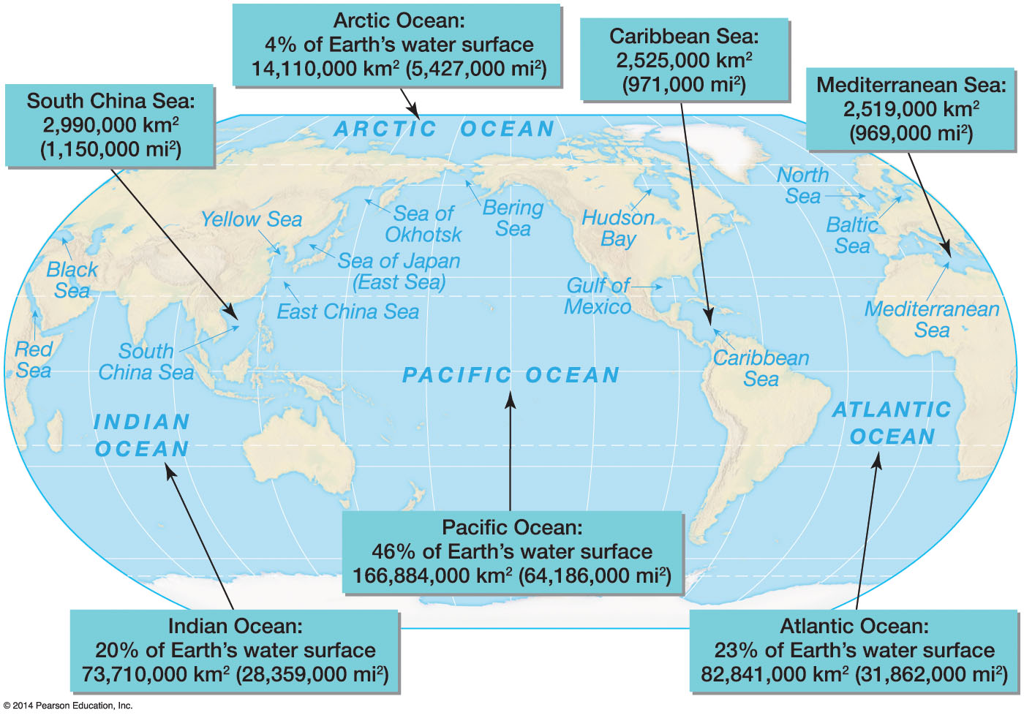

The Oceans
The primary oceans and seas

Slide 6
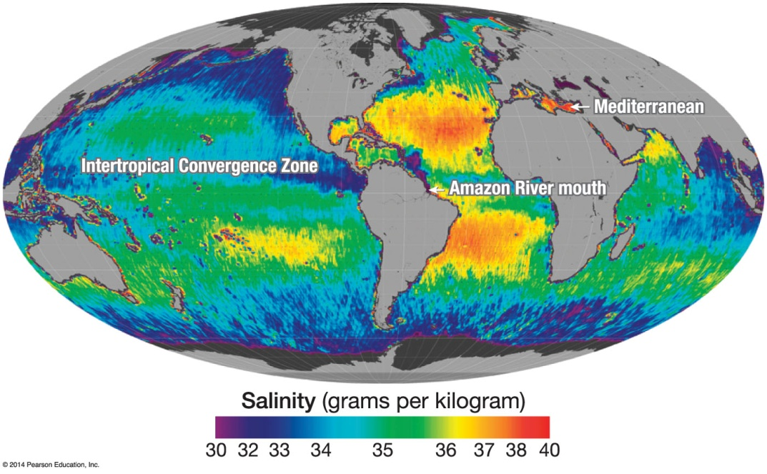
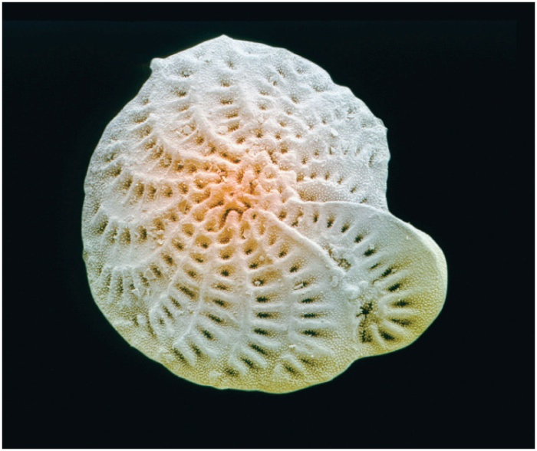

The Oceans
Characteristics of ocean waters
Chemical composition
Sodium and chlorine
Salinity
Increasing acidity
Carbon dioxide absorbed by ocean water creates carbonic acid
Affects the ability of microscopic creatures to build shells and exoskeletons

Slide 7

The Oceans
Characteristics of ocean waters (cont.)
Temperature
Decreases with increasing latitude
Ranges from near 80°F to near 28°F
Density
High temperature means low density
High salinity means high density

Slide 8

Movement of Ocean Waters
Three primary groupings: tides, currents, and waves
Tides
Bulges in sea surface in some places that are compensated by sinks in the surface at other places
Significant in shallow water areas for horizontal placement of water
Causes of tides
Gravitational attraction of Moon (lunar tides) and Sun (solar tides)
More gravitational force on the side of Earth facing the Moon
More centripetal force on opposite side to keep Earth in orbit
Two bulges form on opposite sides of planet

Slide 9
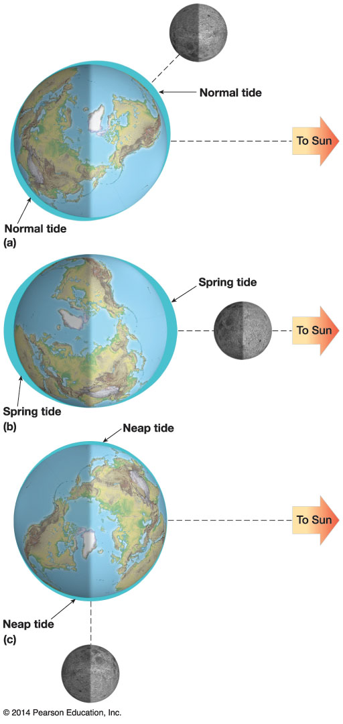

Movement of Ocean Waters
Activity/Animation

Slide 10
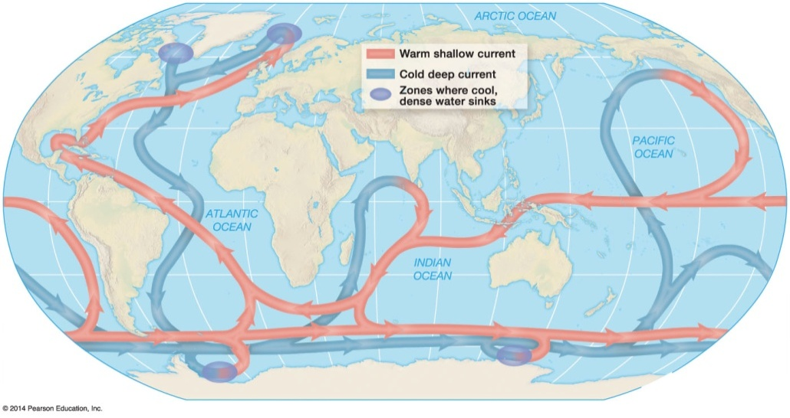

Movement of Ocean Waters
Currents
Subtropical gyres develop from surface wind patterns
Deep ocean circulations
Result from differences in salinity and temperature in deep ocean water
Thermohaline circulation
Water in northern latitudes is colder and higher salinity, so it sinks
Global conveyer-belt circulation
Waves
Minor disturbances to sea surface

Slide 11
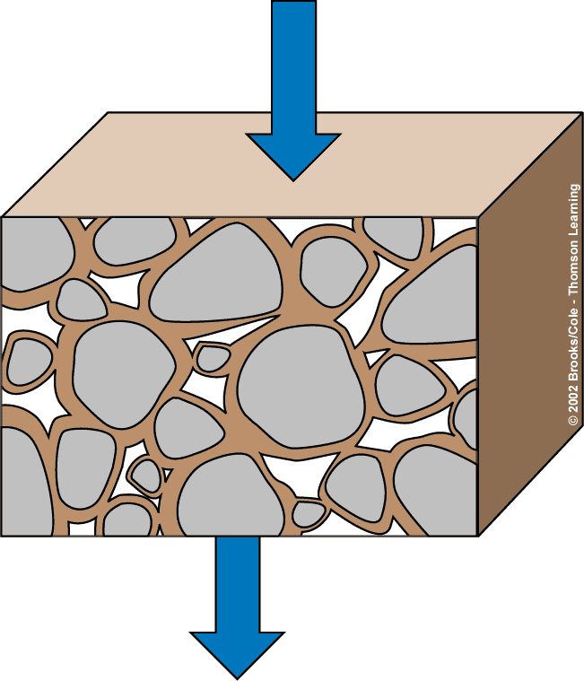
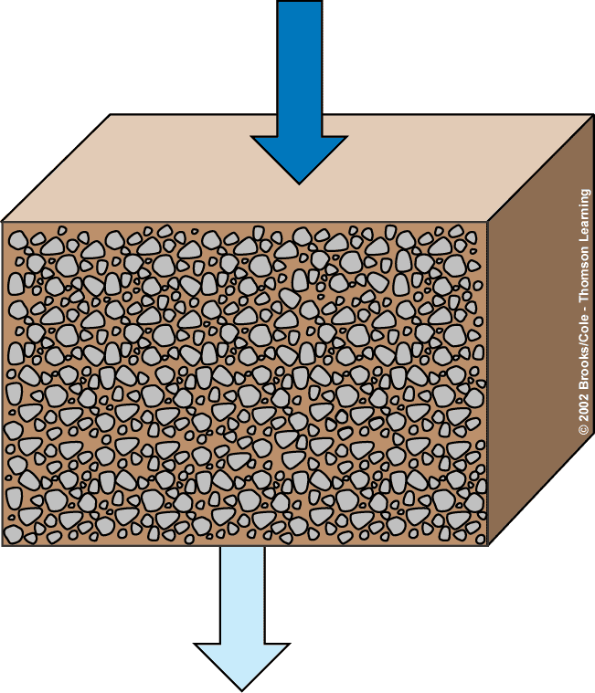

Groundwater
Water
Water
High permeability
Low permeability
Sand, gravel
Clay, granite
Porosity-storage
Permeability-Transport
Notes:
Infiltration-downward movement
Leaching- dissolving of soil components into soil.
Pore space/ permeability- transportation
Clay=sticky, silt=flour, sand-gritty
pH affects the uptake of minerals-displacement of ions in soil. Vulnerable to pests. Affects how plants grow.

Slide 12
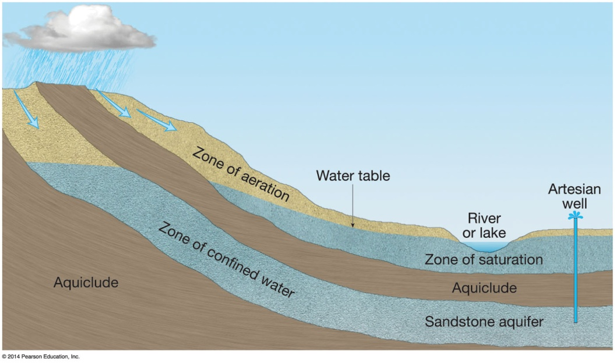

Groundwater
Water beneath land surface world-wide
50% within 800 meters
Precipitation or water basins are the sources
Quantity held depends on
Aquifers and aquicludes

Slide 13

Groundwater
Zone of aeration
Topmost band in underground water supply
Water amount fluctuates rapidly with time
Zone of saturation
All pore spaces filled with water, called groundwater
Top of the zone is the water table
Well water drawn faster than replenished creates a cone of depression

Slide 14
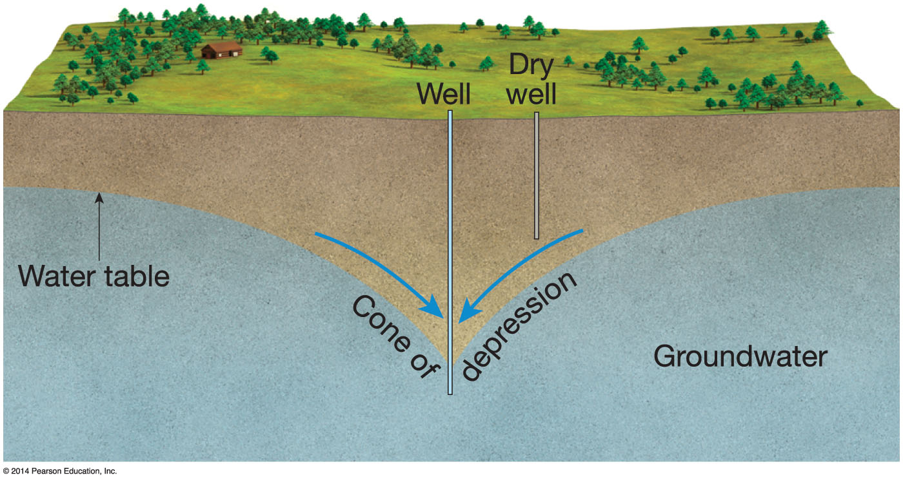

Notes:
Chapter 9, Figure 9.29 Labeled

Slide 15
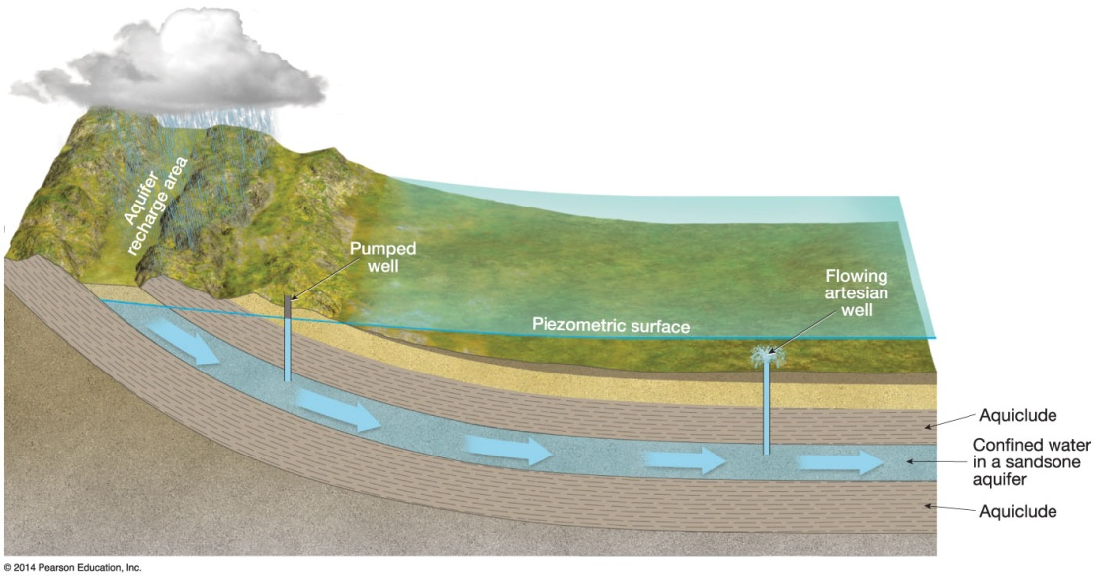

Groundwater
Confined aquifer
Pressure at the great depth of the water will cause water to rise to piezometric surface
Artesian well versus sub-artesian

Slide 16
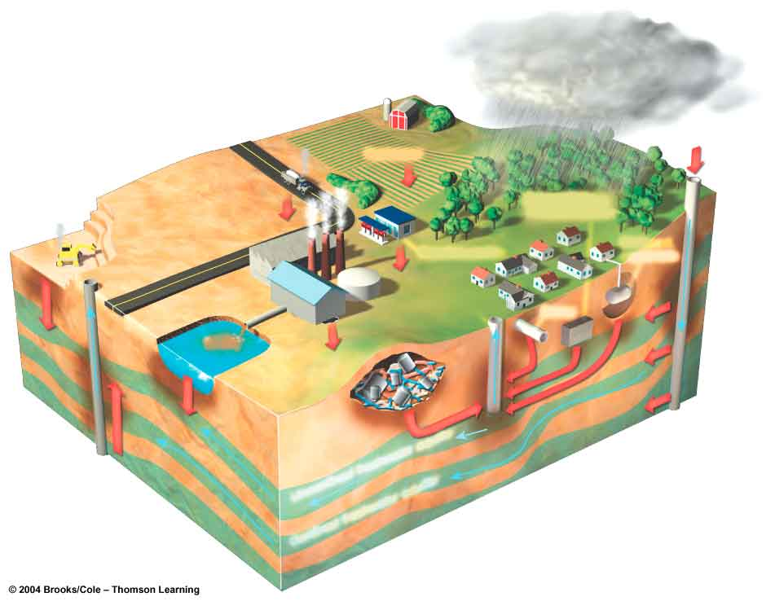

Groundwater Pollution: Causes
Hazardous waste Disposal
Monitor aquifers
Hazardous waste injection well
Pesticides
Coal strip mine runoff
De-icing road salt
Buried gasoline and solvent tank
Pumping well
Cesspool septic tank
Gasoline station
Waste lagoon
Water pumping well
Sewer
Landfill
Accidental spills
Leakage from faulty casing
Discharge
Unconfined freshwater aquifer
Confined aquifer
Confined freshwater aquifer
Groundwater flow
Fig. 20-11

